Slide 1
Lectuer-1 Database Design and Applications
Ashish Narang

Slide 2
First Semester
2020-21

Slide 3
Course Contents
1. Introduction and Overview of DBMS
2. Conceptual Database Design (ER Modeling)
3. Relational Model
4. Relational Algebra and Calculus
5. SQL
6. Schema Refinement and Normal Forms
7. Disk Storage
8. Hashing and Indexing
9. Transaction Management and Concurrency Control
10.Database Recovery and Database Security
11. Recent Trends in Databases

Slide 4
Books
R Ramakrishnan & J Gehrke, Database Management Systems, Mc Graw Hill, 3rd Ed., 2003.
Elmasri, Ramez, Shamkant B. Navathe, Fundamentals of Database Systems, Pearson Education, 5th Ed., 2007.
Date C.J., An Introduction to Database Systems, Pearson, 8th Ed., 2006.
Korth H F and A Silberschatz, Database System Concepts, MGHISE, 3rd Ed., 1997.

Slide 5
Lecture -1 Contents
Introduction to database
DBMS
Database System environment
Traditional file systems for storing data
Advantages of DBMS over traditional file systems
Data Models
Three Schema Architecture
Data Independence
Structure of DBMS
People Who Work with DBMS

Slide 6
Introduction
Database Systems have become significant component of any present day business.
Databases help businesses to perform their day to day activities.
Examples include Banking System, Travel ticket reservation, Library catalog search.
Advances in technology have given rise to new concepts
Multimedia databases
GIS
Data warehousing and mining

Slide 7
Contd..
Data: Known fact that can be recorded and that has implicit meaning.
Ex. Name, Tel_no, city etc.
Database: It is a collection of logically related data.
A database is designed, built and populated with data for a specific purpose.

Slide 8
Database Management System
DBMS: Is a collection of programs that enables users to create and maintain databases.
DBMS is a software system that facilitates the following:
1.Defining the database
2.Constructing the database
3.Manipulating database for various applications

Slide 9
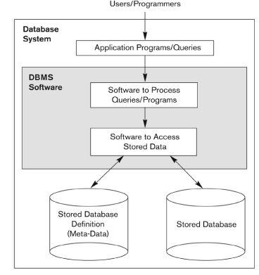
Database System Environment

Slide 10
Traditional File Systems
If we take the example of savings bank enterprise, information about customers and savings accounts etc. need to be stored.
One way to keep the information on computers is to store in the files provided by operating systems (OS). This approach has certain disadvantages.
Difficulty in accessing data (possible operations need to be hardcoded in programs).
Redundancy leading to inconsistency.
No recovery on crash.
The security provided by OS in the form of password is not sufficient.
Data Integrity is difficult to maintain

Slide 11
Advantages of using DBMS
Controlling Redundancy
Efficient Data Access
Data Integrity and Security
Concurrency Control
Crash Recovery
Reduced Application Development time

Slide 12
Disadvantages of Database Approach
Extra Cost due to Hardware, Software and Training.
Overhead for providing security, concurrency control, recovery and integrity functions.

Slide 13
Data Model
Data model is a collection of high-level data description constructs that hide many low-level details.
Semantic data models: More abstract high-level data models that make it easier for a user to come up with a good initial description of the data in an enterprise. Contain wide variety of constructs that help describe a real-world enterprise data.
Ex. ER model
Representational / Implementation data models: These are DBMS specific data models and are built around just few basic constructs.
Ex. Relational data model, Object data model

Slide 14
Contd..
Relational Model: The central data description construct in this model is a relation, which can be thought of as a set of records.
Schema: Description of data in terms of a data model is called a schema. A relation schema specifies the name of the relation, field, type etc.
Ex. Student (sid: string; name: string; age: integer)

Slide 15
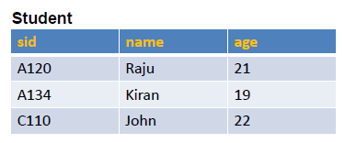
Instance of a Relation
A schema can be regarded as a template for describing a student.
We can specify integrity constraints which are conditions that need to be satisfied by records in the relation. Ex. uniqueness

Slide 16
Representational Data Models
Network Model: Though the basic structure is a record, the relationships are captured using links. The database can be seen as an arbitrary network of records connected by links. Ex.: GE’s Integrated Data store (IDS), in Early 1960s
Hierarchical Model: The records containing data are organized as a collection of trees. Ex.: IBMs IMS (Information Management System), in late 1960s
Relational Model: (early 1970s)Data & relationships are captured as tables & keys.
Ex.: Oracle, IBMs DB2, MySQL, Informix, Sybase, MS Access etc.

Slide 17
Three Schema Architecture
A database can be described using three different levels of abstractions. Description at each level can be defined by a schema.
External schema: Used to describe the database at external level. This allows data access to be customized at the level of individual users/groups/applications. This schema design is guided by end user requirements.
Conceptual schema (logical schema) Describes the stored data in terms of the data model specific to that DBMS. In RDBMS conceptual schema describes all relations that are stored in the database.
Physical schema: Describes the physical storage strategy for the database.

Slide 18
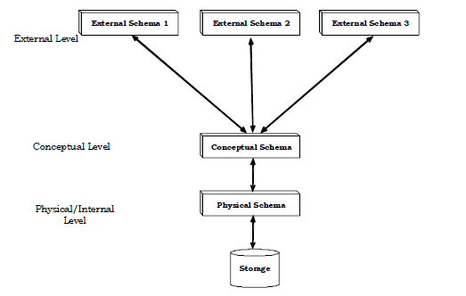
Contd..

Slide 19
Contd..
Data Independence: The three-level architecture which is the result of the three-level abstraction on database, leads to data independence.
Logical data Independence: changes in conceptual level schema should not affect the application level or external level schemas.
Physical data Independence: The changes in physical features of storage, i.e., changes to the physical storage format should not affect schema at conceptual level. The above data independence is one of the important advantages of DBMS.

Slide 20
Queries
The ease with which information can be obtained from a database often determines its value to the user.
RDBMS allows users to pose a rich class of questions in the form of queries. Relational data model has powerful query languages
Formal query languages (based on strong mathematical logic)
Relational algebra
Relational Calculus
Commercial query language
SQL

Slide 21
Transaction
A transaction is a collection of operations that perform a single logical operation or function in a database application.
Each transaction is a unit of atomicity.
A transaction is an atomic unit of work that is either completed in its entirety or not done at all.
For recovery purposes, the system needs to keep track of
when the transaction starts, terminates, and commits or aborts.

Slide 22
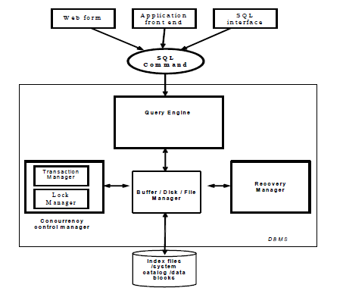
DBMS Structure

Slide 23
People who work with DBMS
Database Designers
End users
Application Programmers
Database administrator (DBA)

